Slide 1

Safety First
Greeting/Circle Time
Caregiver Information
Rules and Expectations
Attendance
Calendar
Weather
Books
Videos

Slide 2
Greeting
Using Consistent Language” Tell the student what “To Do”

Slide 3
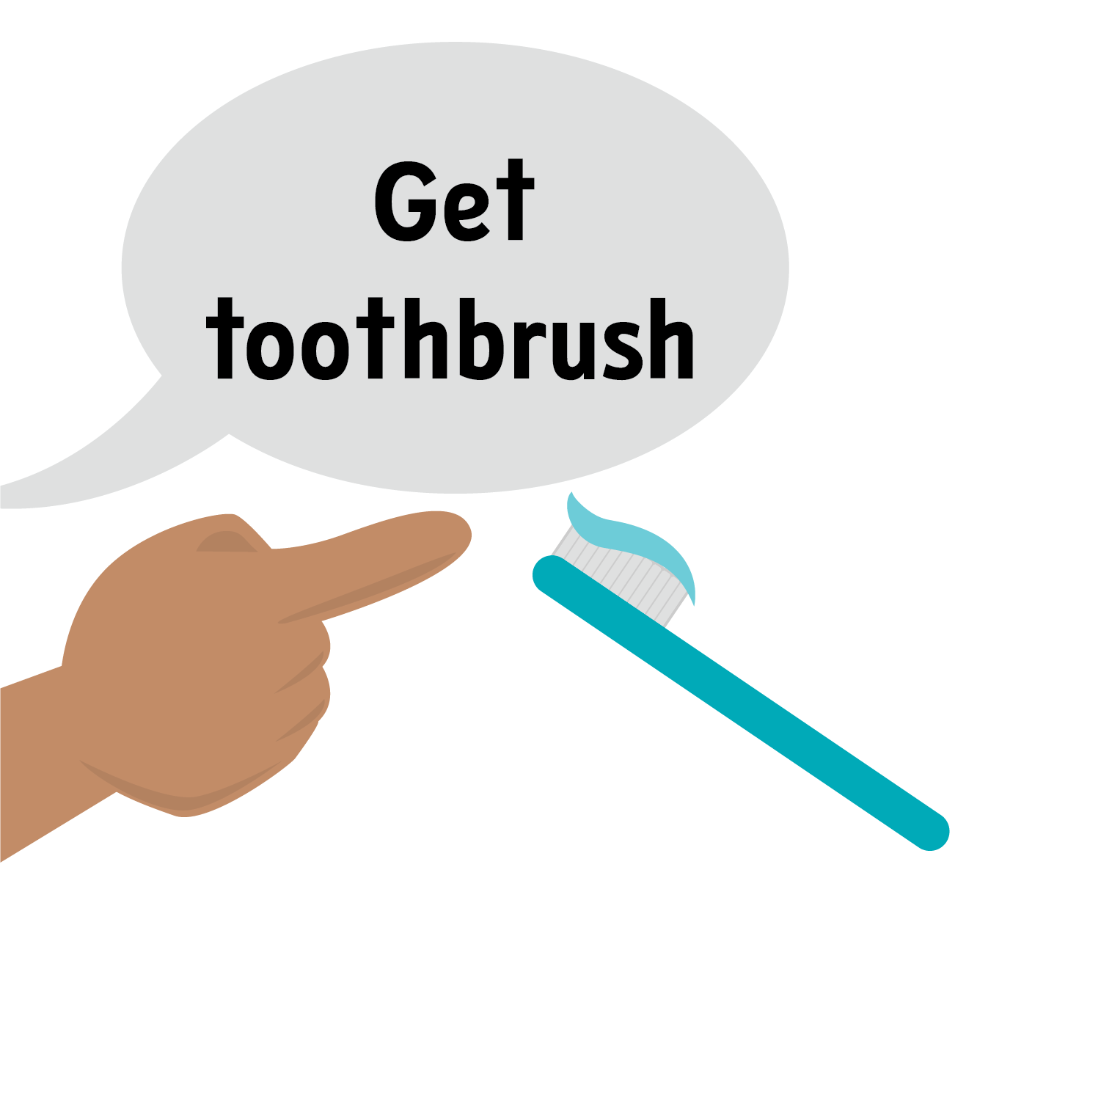
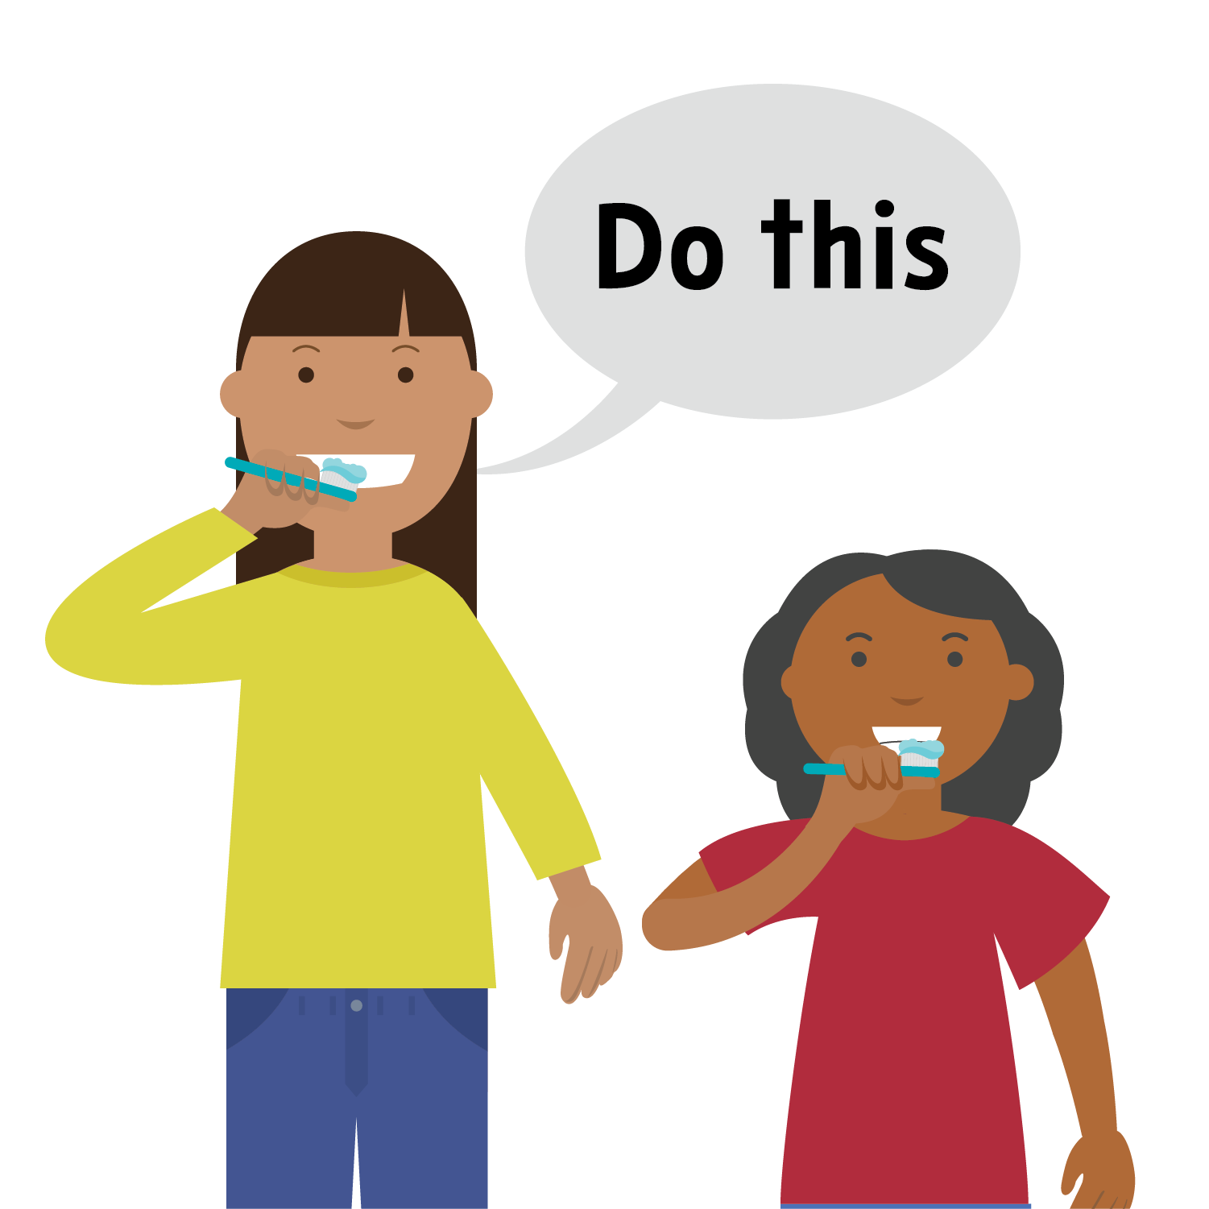
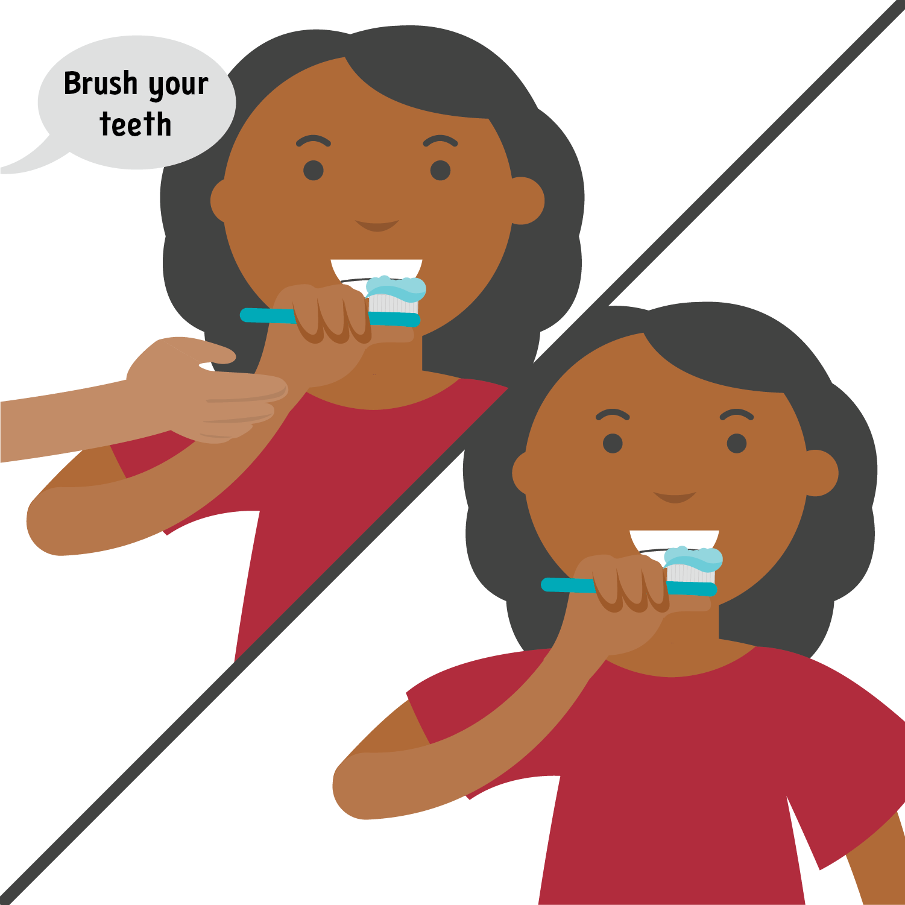
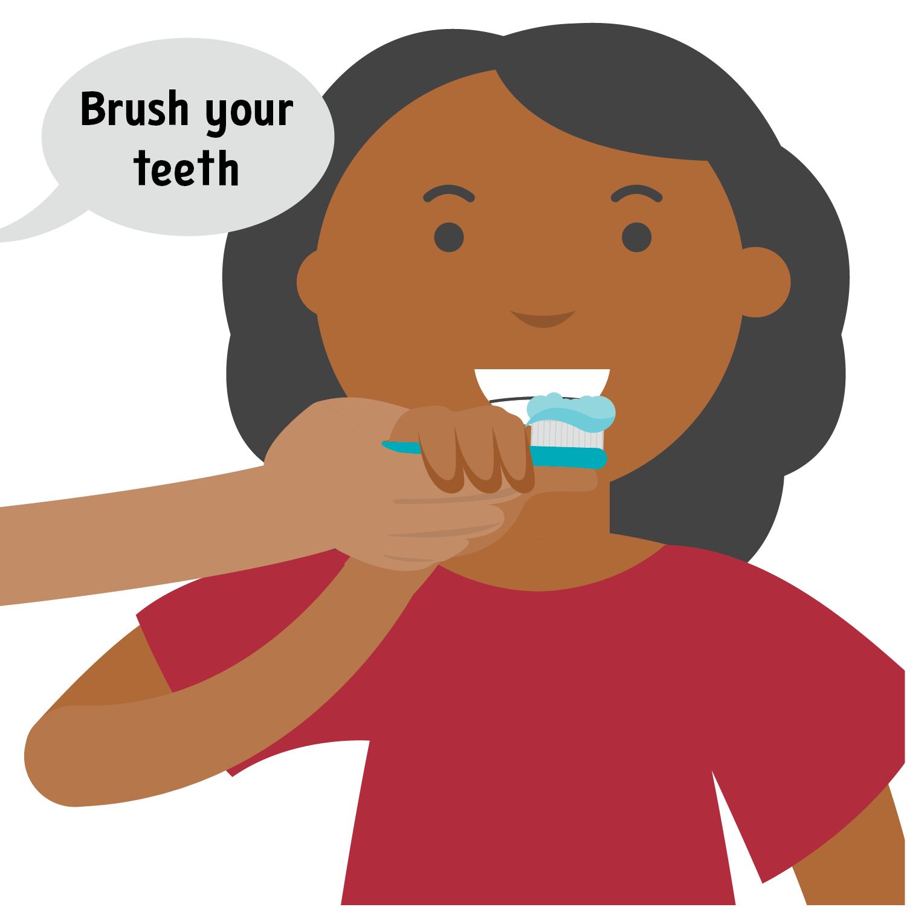
Greeting
Using Consistent Language: Tell the student what “To Do”
Always use the least intensive prompt necessary to help your child be successful
Fade your prompts as quickly as possible.
Verbal, visual, or gestural prompt
Model prompt
Partial physical prompt
Full physical prompt

Slide 4
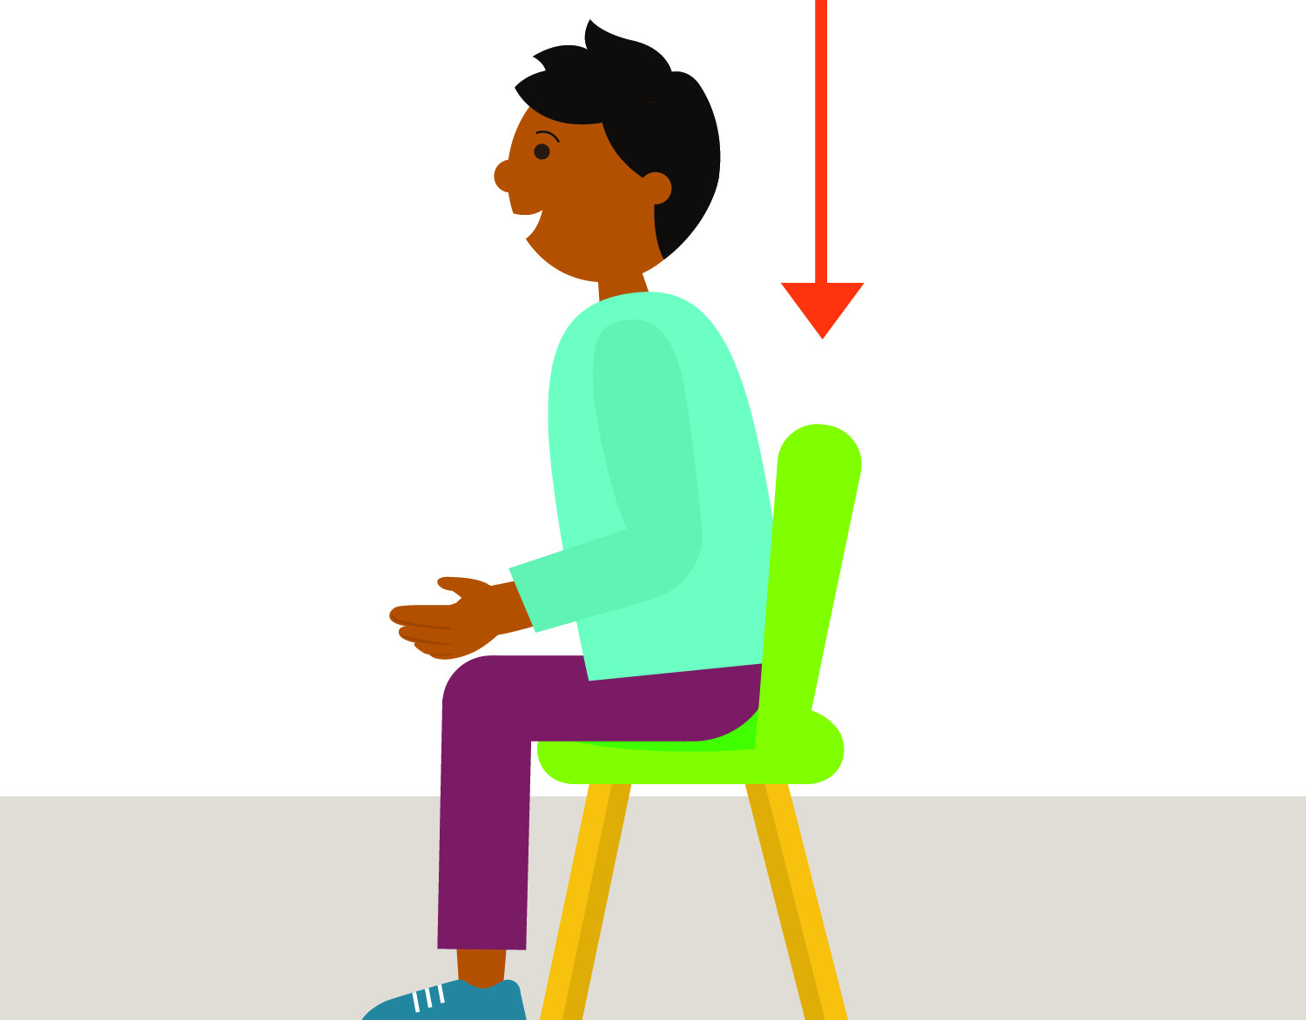
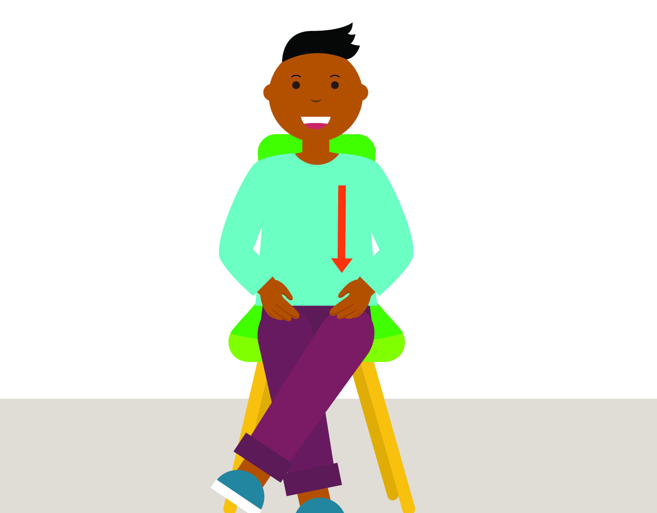

Greeting
Rules and Expectations
Sit in chair
Hands down
Look at teacher

Slide 5

Greeting
Hello Song
Notes:
nfqqWdTJ

Slide 6


Greeting
Attendance

Slide 7
Greeting/Circle
Calendar

Slide 8





Greeting/Circle Time
Weather
The weather is…
Raining
Cloudy
Sunny
Snowing

Slide 9
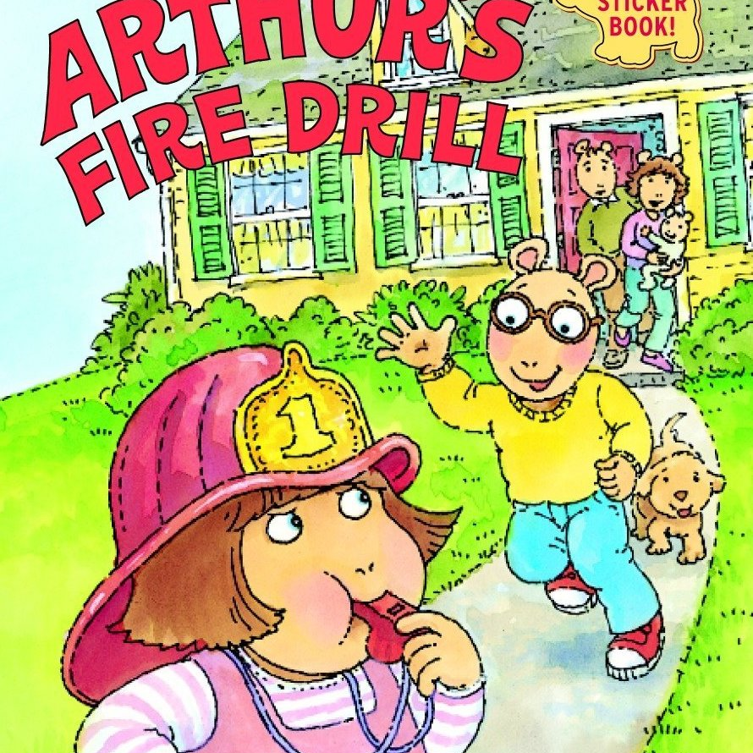


Greeting/Circle
Books
Notes:
Arthur: h65XKwsO
George: bTiK40yO
Stop, Wait, Go: tOyngGRT

Slide 10


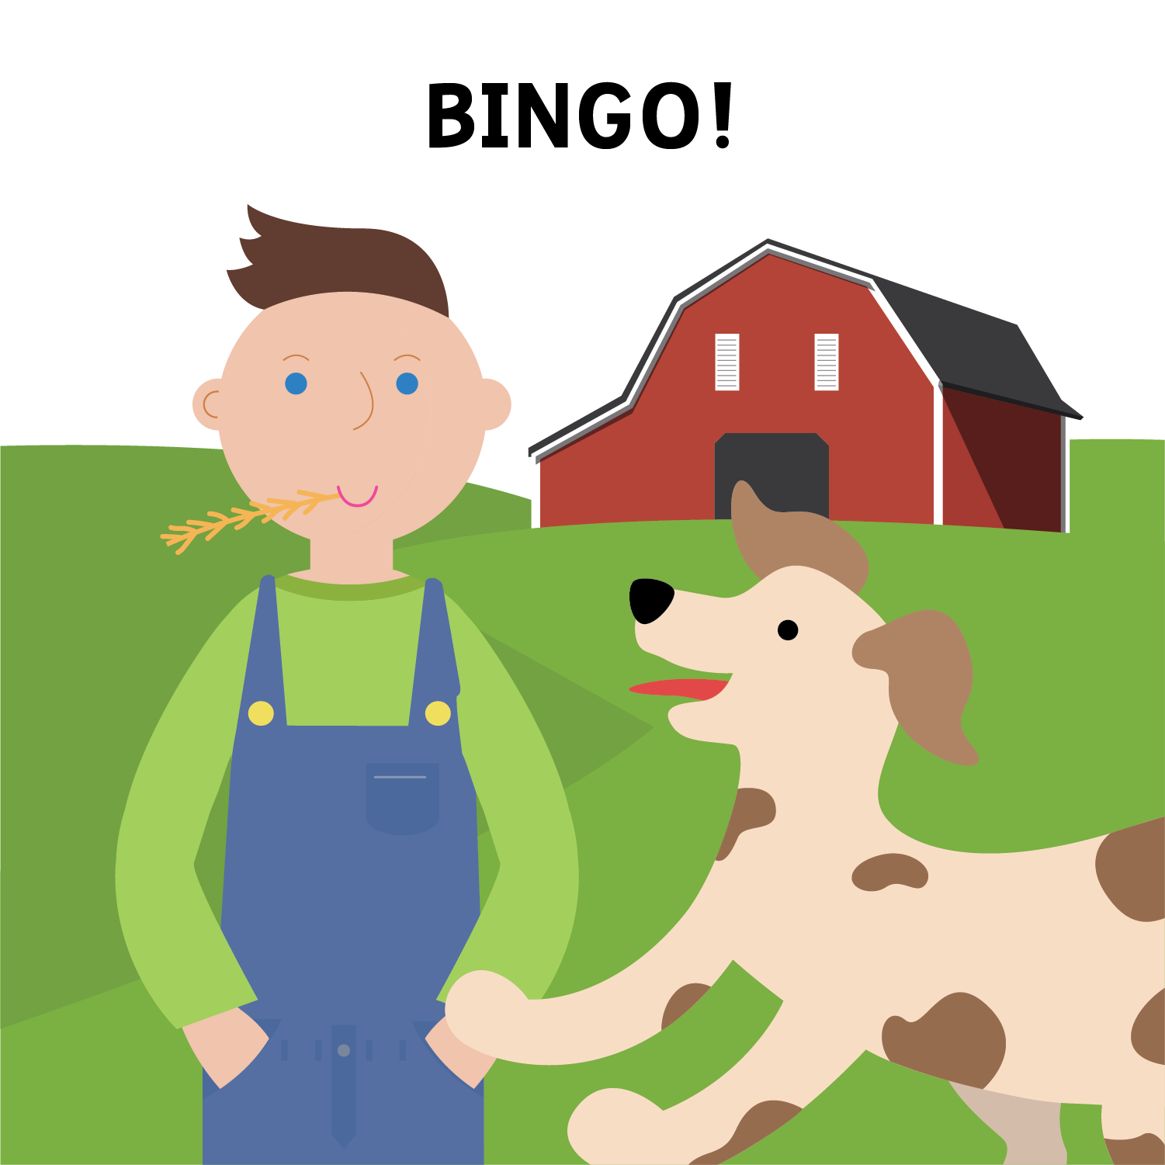
Greeting/Circle Time
Songs
Notes:
Twinkle:xPlQVV67
Happy: DabBN2g1
BINGO: kuC1G0YI

Slide 11



Greeting/Circle Time
Chuckle Time: Jokes and Magic Tricks
Notes:
Jokes with peyton set 15: FfJK2XiC
Changing Size Strip: GpXNMTni
Jokes with peyton set 16: uj2vm3hy

Slide 12
Greeting/Circle Time
Finished

